Slide 1











Student Performance Predictor Project
Predicting Student Performance Using Machine Learning

Slide 2



Introduction
  Project Background: the Student Performance Predictor project aims to forecast academic success using machine learning techniques.
  Importance: Early identification of at-risk students allows for timely interventions to enhance educational outcomes.
  Goals: Develop a predictive model to identify students likely to pass or fail based on their academic and demographic data.

Slide 3

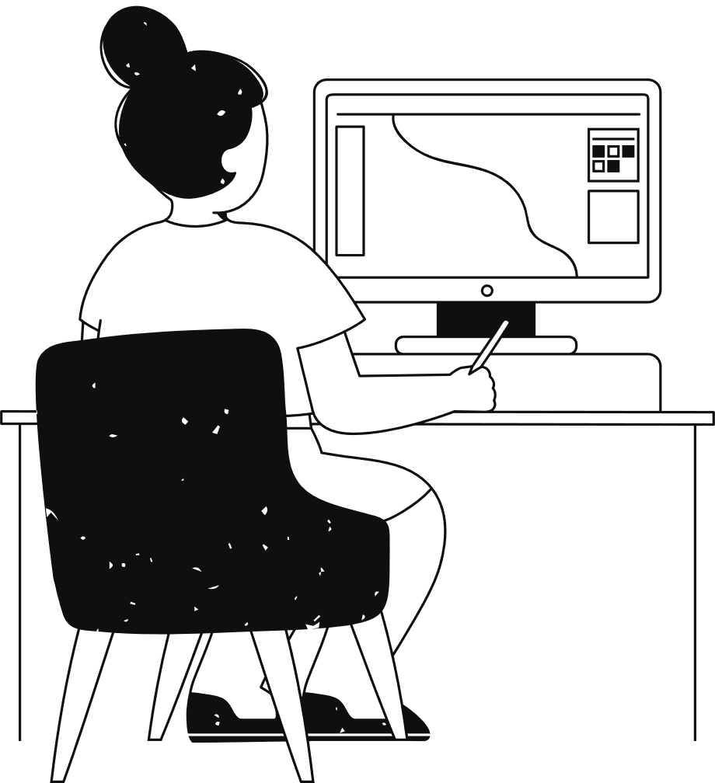

Project Scope
01.
Topic Selection
05.
Algorithm Selection
Model traning and Evaluation
02.
Data Collection
06.
03.
Data processing
07.
Model improvements
04.
Data visualisation
08.
Data prediction

Slide 4
1. Topic Selection:
Student Performance Predictor
Problem Statement:The goal is to develop a model that predicts student performance based on various factors such as demographics, study habits, attendance, and past academic records.
Impact: Early identification of at-risk students enables targeted educational interventions to support those students.

Slide 5
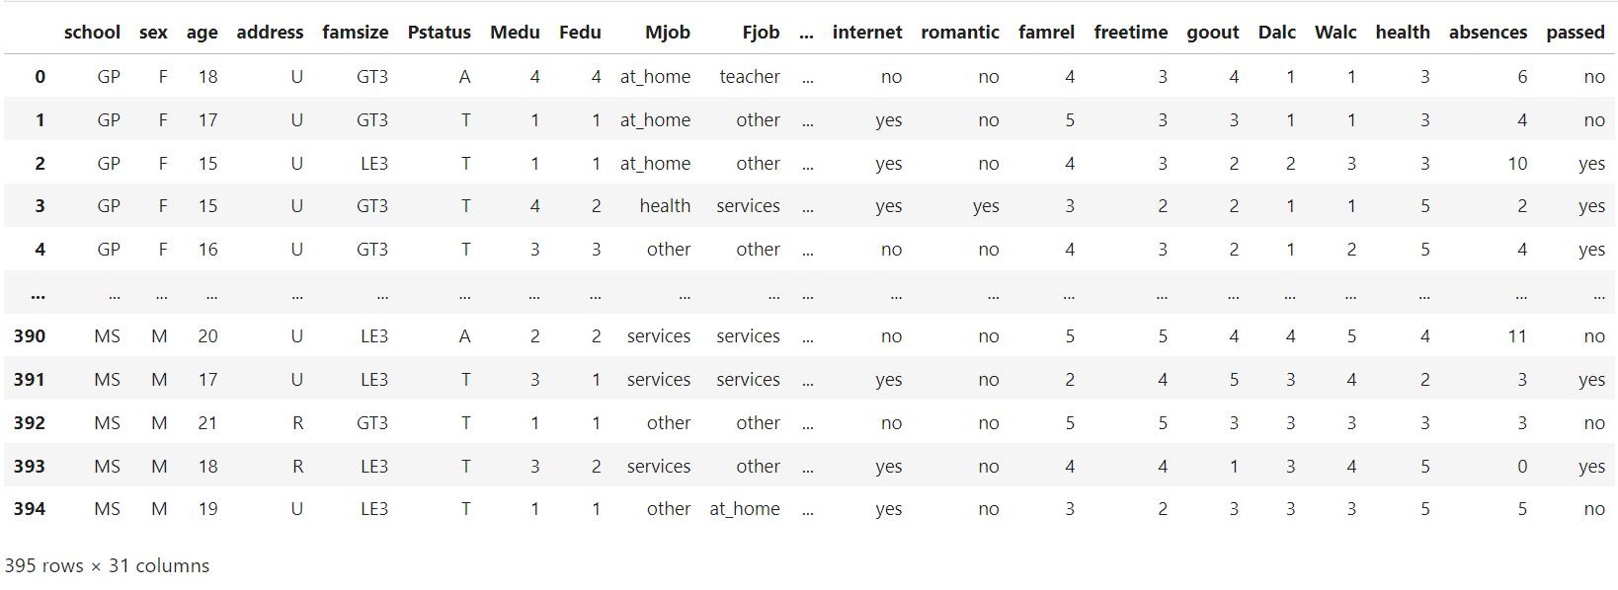
2. Data Collection
Dataset
Records: 395 student records.
Features: Demographics, parental education, study habits, historical academic performance.
Source: UCI Machine Learning Repository.
Preprocessing: Handled missing values.

Slide 6
Dataset features:
school : student's school (binary: "GP" or "MS")
sex : student's sex (binary: "F" - female or "M" - male)
age : student's age (numeric: from 15 to 22)
address : student's home address type (binary: "U" - urban or "R" - rural)
famsize : family size (binary: "LE3" - less or equal to 3 or "GT3" - greater than 3)
Pstatus : parent's cohabitation status (binary: "T" - living together or "A" - apart)
Medu : mother's education (numeric: 0 - none, 1 - primary education (4th grade), 2 - 5th to 9th grade, 3 - secondary education or 4 - higher education)
Fedu : father's education (numeric: 0 - none, 1 - primary education (4th grade), 2 - 5th to 9th grade, 3 - secondary education or 4 - higher education)
Mjob : mother's job (nominal: "teacher", "health" care related, civil "services" (e.g. administrative or police), "at_home" or "other")
Fjob : father's job (nominal: "teacher", "health" care related, civil "services" (e.g. administrative or police), "at_home" or "other")
reason : reason to choose this school (nominal: close to "home", school "reputation", "course" preference or "other")
guardian : student's guardian (nominal: "mother", "father" or "other")
traveltime : home to school travel time (numeric: 1 - <15 min., 2 - 15 to 30 min., 3 - 30 min. to 1 hour, or 4 - >1 hour)
studytime : weekly study time (numeric: 1 - <2 hours, 2 - 2 to 5 hours, 3 - 5 to 10 hours, or 4 - >10 hours)
failures : number of past class failures (numeric: n if 1<=n<3, else 4)
schoolsup : extra educational support (binary: yes or no)
famsup : family educational support (binary: yes or no)
paid : extra paid classes within the course subject (binary: yes or no)
activities : extra-curricular activities (binary: yes or no)
nursery : attended nursery school (binary: yes or no)
higher : wants to take higher education (binary: yes or no)
internet : Internet access at home (binary: yes or no)
romantic : with a romantic relationship (binary: yes or no)
famrel : quality of family relationships (numeric: from 1 - very bad to 5 - excellent)
freetime : free time after school (numeric: from 1 - very low to 5 - very high)
goout : going out with friends (numeric: from 1 - very low to 5 - very high)
Dalc : workday alcohol consumption (numeric: from 1 - very low to 5 - very high)
Walc : weekend alcohol consumption (numeric: from 1 - very lo to 5 - very high)
health : current health status (numeric: from 1 - very bad to 5 - very good)
absences : number of school absences (numeric: from 0 to 93)
passed : did the student pass the final exam or not (binary: yes or no)

Slide 7
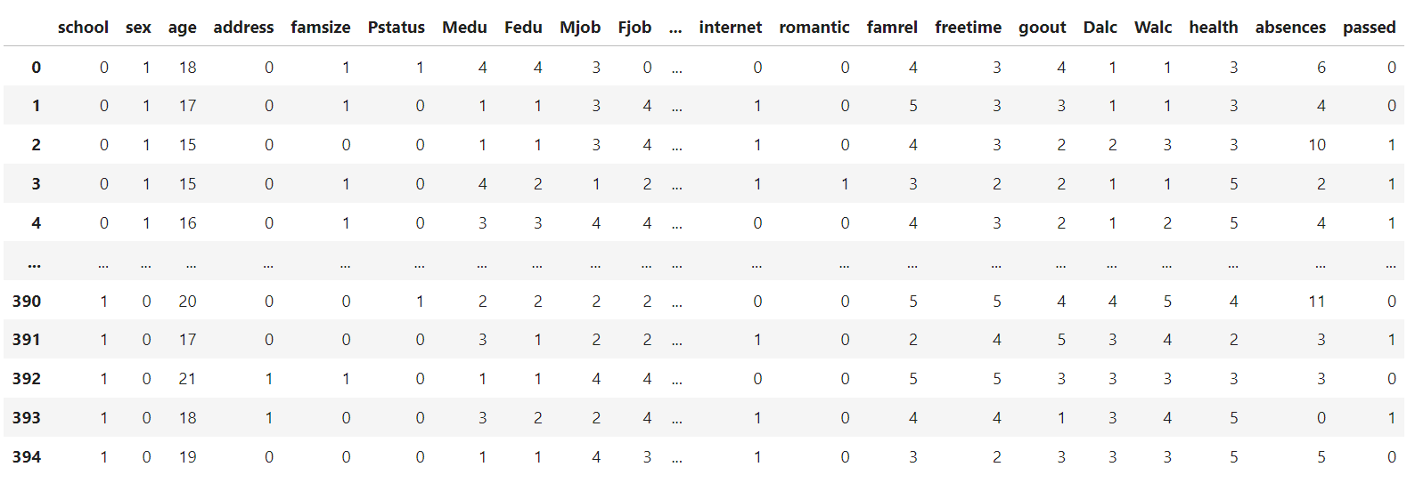
3.Data processing
Before working with any dataset, we must process that dataset so that it is ready to train our models. We processed our dataset in several steps:
Data Encoding : Categorical variables were transformed into numerical formats through label encoding to facilitate their use in our models.

Slide 8
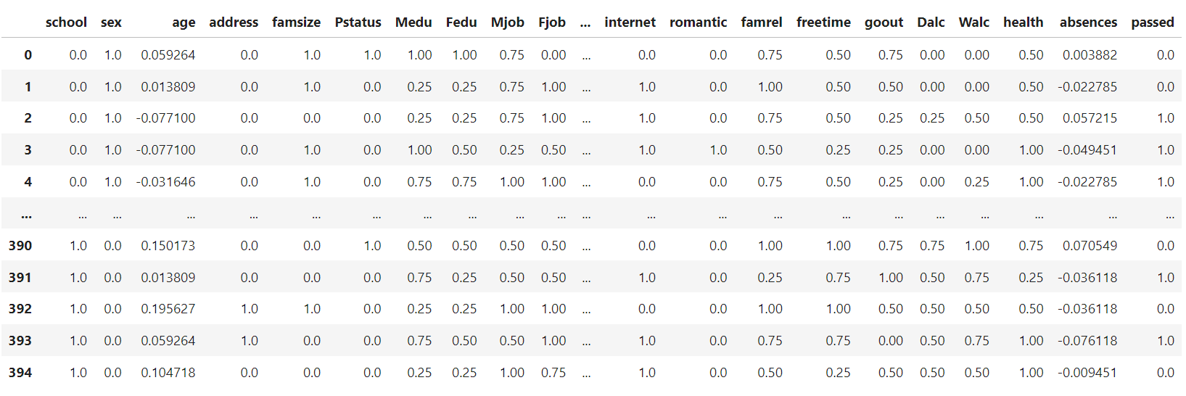
2. Feature Scaling and Normalization: Numerical features underwent standardization (subtracting the mean and scaling to unit variance) and Min-Max scaling to ensure uniformity in range and scale, enhancing model performance.
    - Here we use function takes the dataset as an argument and replaces each "col", with : $\frac{col−mean(col)}{max(col)}$ where mean : mean or the median.
- also It has been found that the following equation works well for scaling : $\frac{col−mean(col)}{std(col)}$ where std : standard deviation.

Slide 9
3) we divide the data set into training (80%) and test (20%) sets.
4) Apply SMOTE function to balance the training set since the dataset contains the target variable passed, which is imbalanced with 265 instances of yes and 130 instances of no.
5) Check for missing values and replace them with the median or mode.
6) Check for NaN values

Slide 10

4. Data visualisation
features visualization
We will take a deeper look at each feature using different visualization techniques such as Correlation Heatmap and distribution plots and density plots.
After visualization, we will understand its impact on students' performance.

Slide 11
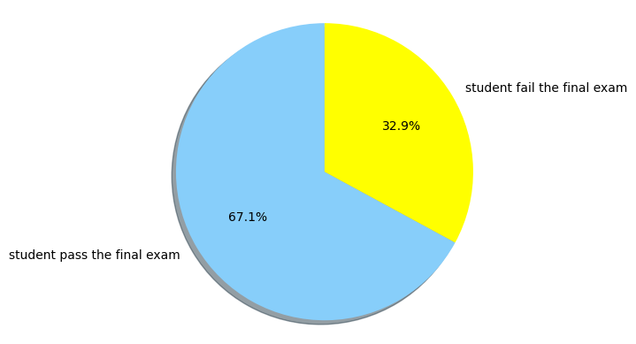
plot of student status
It is likely that most students succeeded in the exam, and our goal is to minimize student failure as much as possible.

Slide 12
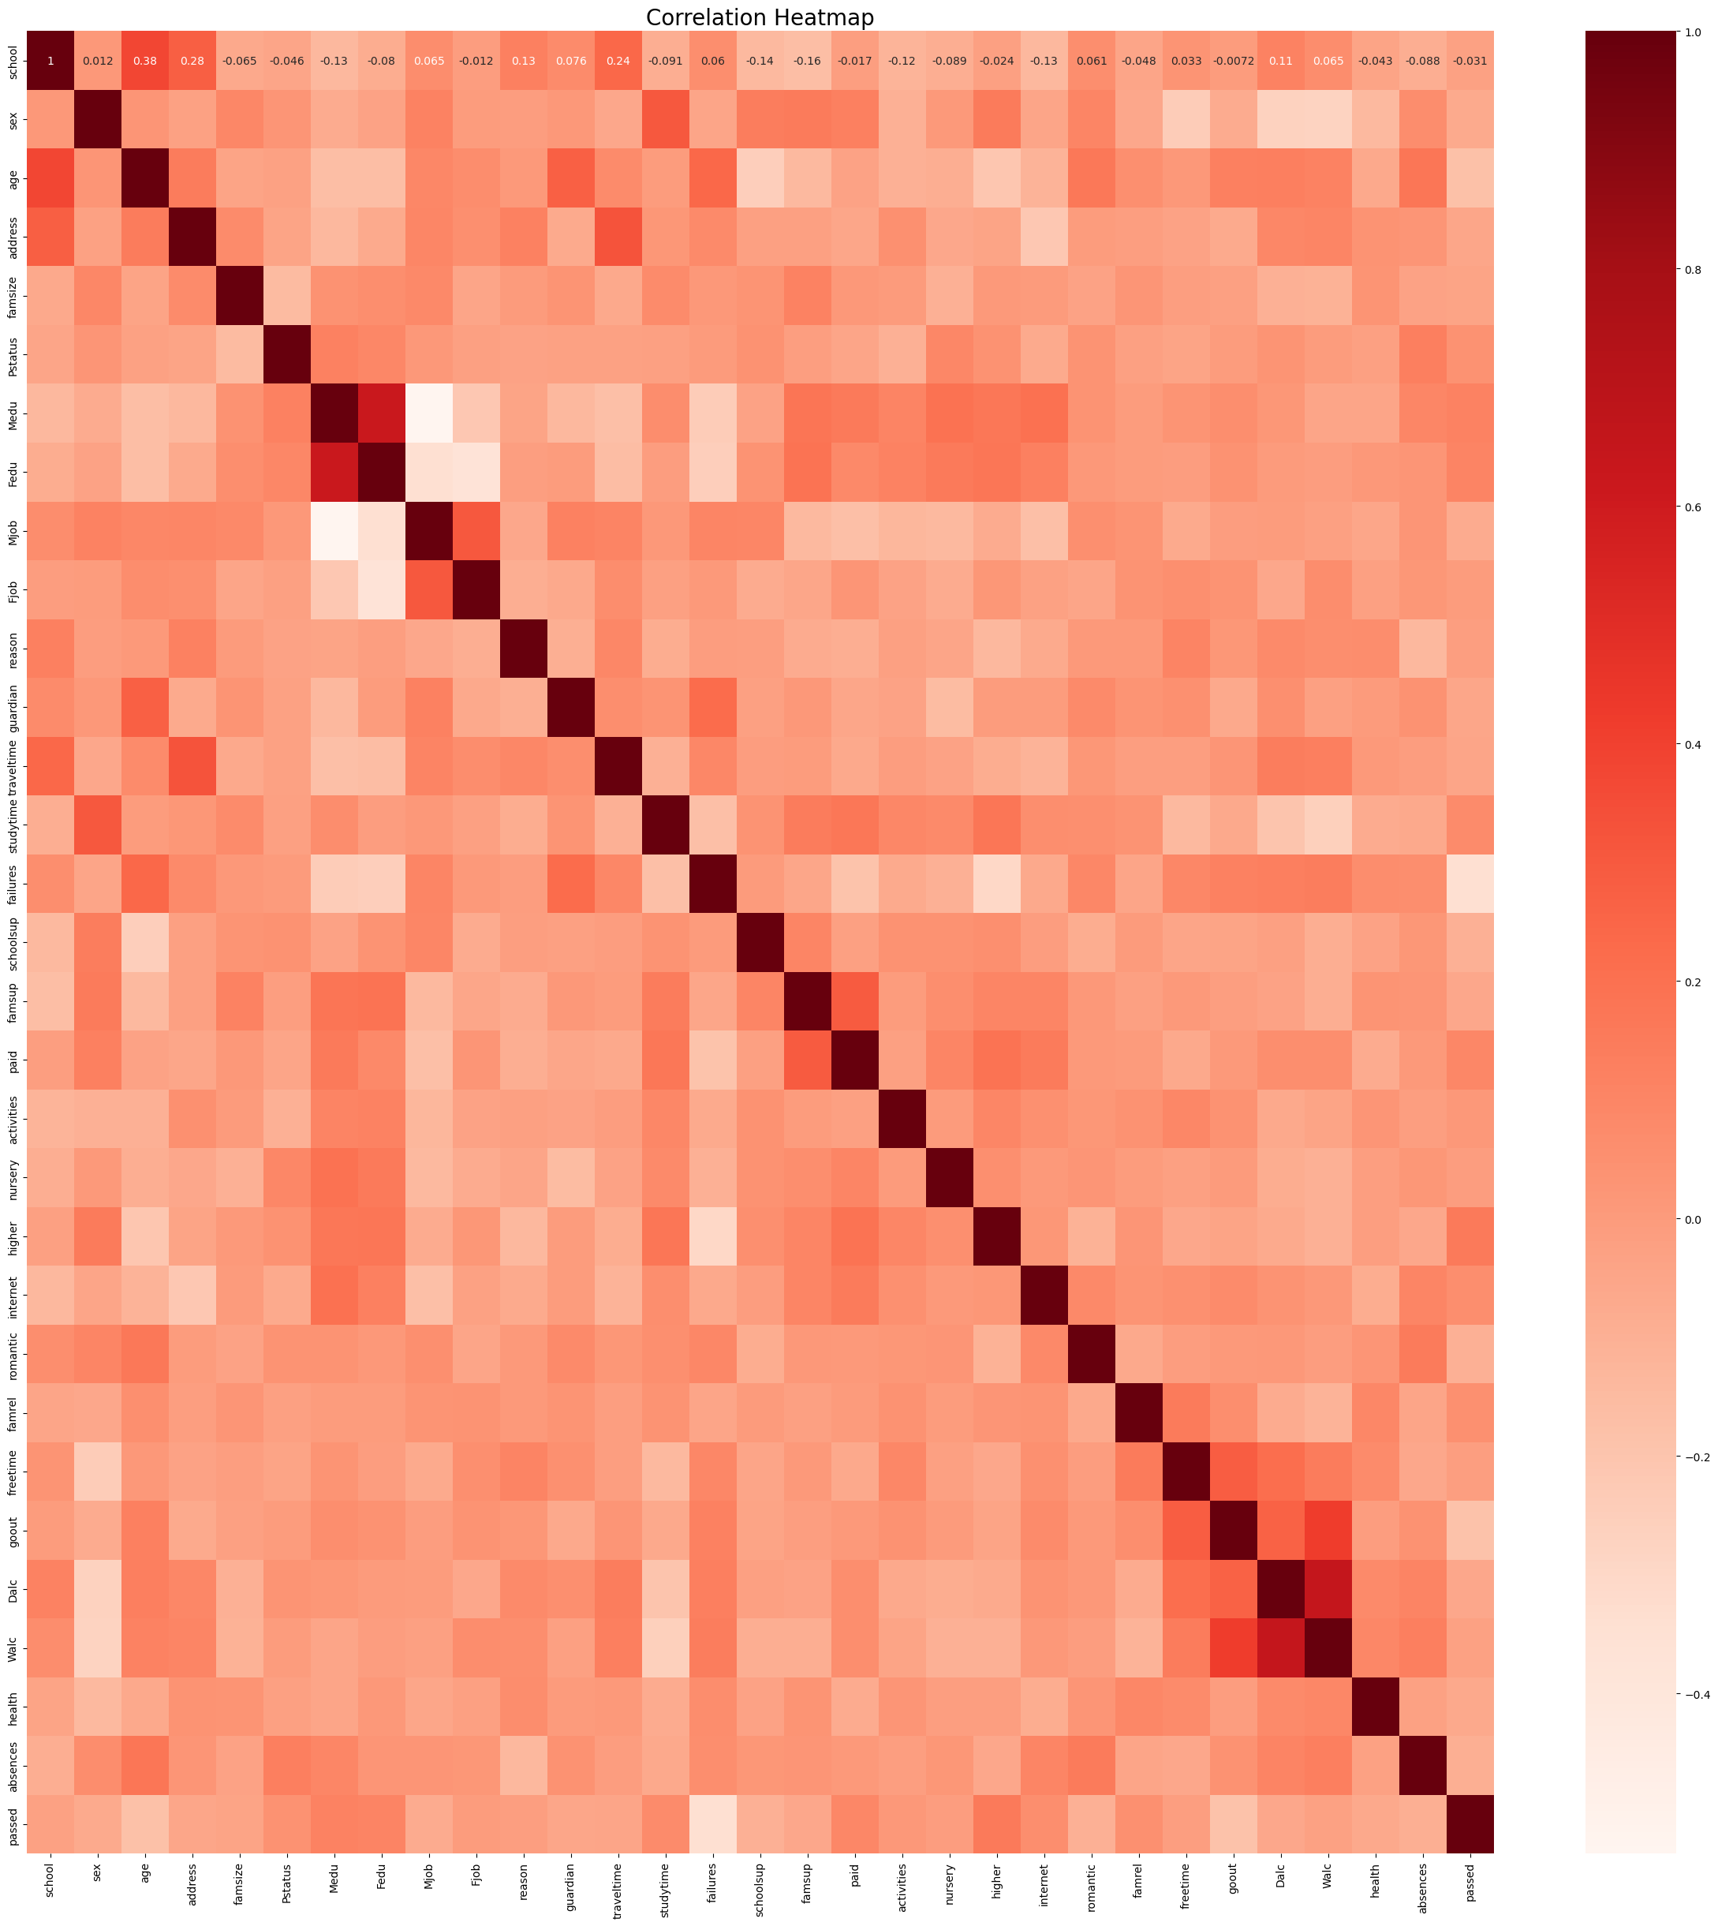
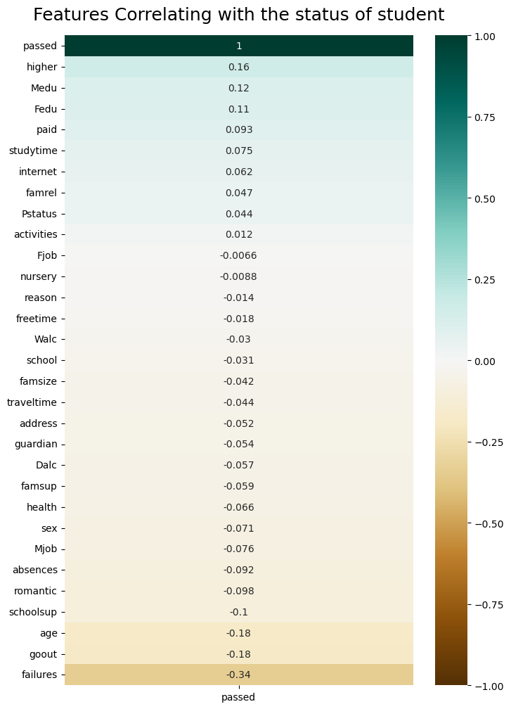
Correlation Heatmap
here we have two tayps of Correlation Heatmap to Visualize relationships between variables and Identify features most associated with passing or failing where darker colors indicate stronger correlations.

Slide 13
Correlation Heatmap Insights :
Past Failures: Strong negative correlation with final grade. More past failures lead to lower final grades.
Study Time: Positive correlation with final grade. More study time leads to higher grades.
Parental Education: Higher parental education (both mother and father) correlates positively with better student performance.
Going Out: Negative correlation with final grade. Frequent social outings lead to lower grades.
Alcohol Consumption: Both weekday and weekend alcohol consumption negatively correlate with final grades.
School Support: Slight negative correlation. Students needing extra support tend to struggle more.
Family Relationship Quality: Slight positive correlation. Better family relationships contribute to better grades.
Health Status: Slight positive correlation. Healthier students tend to perform better.
Age: Slight negative correlation. Older students tend to have lower grades.
Internet Access: Positive correlation. Access to the internet supports better academic performance.

Slide 14
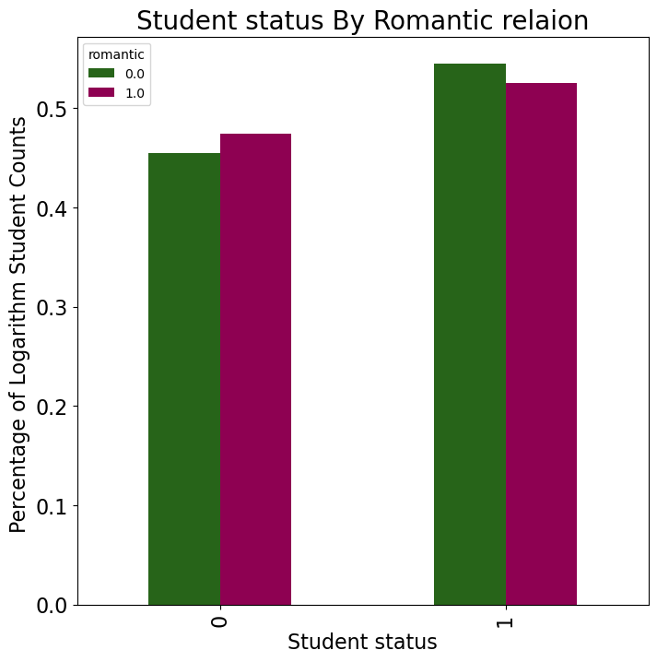
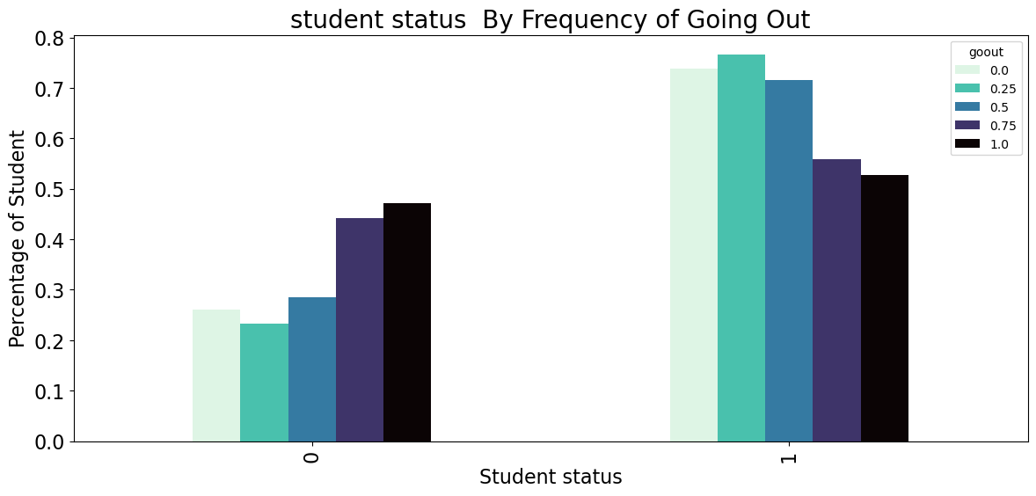
Students not in a romantic relationship have a higher percentage of passing.
Students in a romantic relationship have a slightly lower percentage of passing.
Students who go out less frequently (lower values on the scale) have a higher percentage of passing.
Students who go out more frequently (higher values on the scale) have a lower percentage of passing.

Slide 15
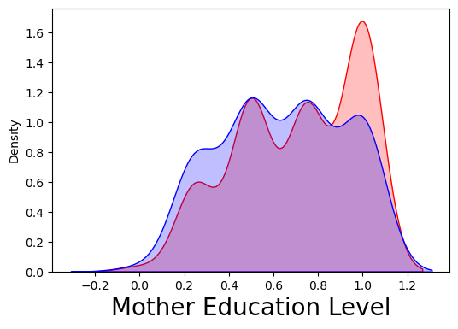
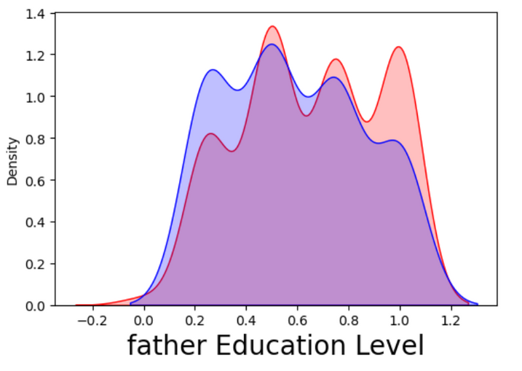
Student status by father and mother education:
From the graphs, it appears that both maternal and paternal education have an impact on student performance, as we see higher density at higher educational levels for both parents.

Slide 16
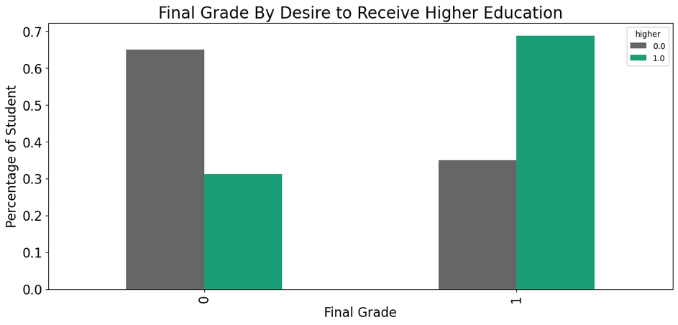
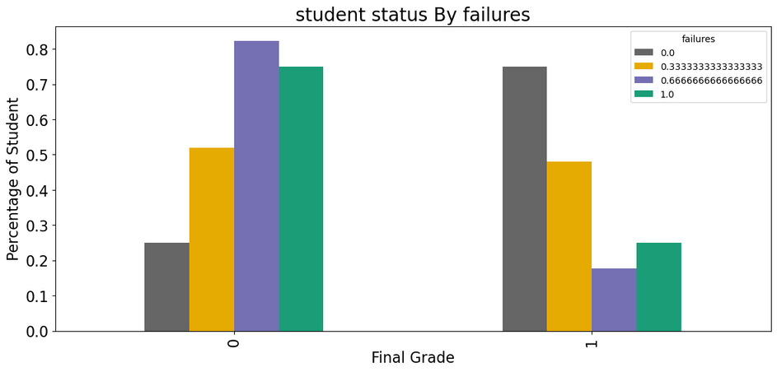
Student status by deseire to take heigher education:
Student status by failures:
Most of students who passed the exam want to take heigher education sow it could be a good idea to encourage your kids or students to take heigher education.
most of student who passed the exam had 0 failures

Slide 17
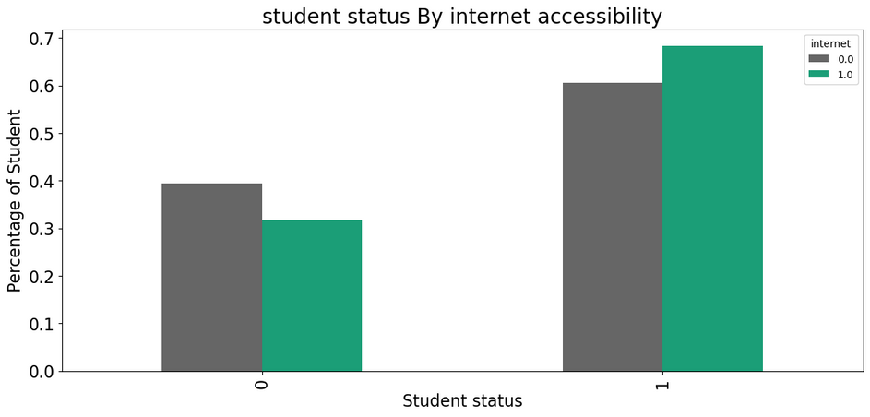
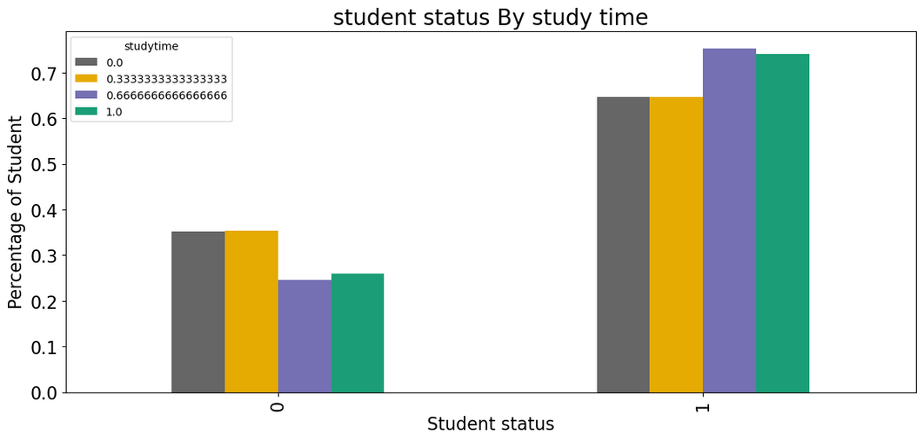
Student status by internet accessibility:
Student status by weekly Study time :
Most of the students who passed the exam had access to the internet, so we should provide fair educational materials.
Most of students who passed the exam study 5-10 hours weekely

Slide 18
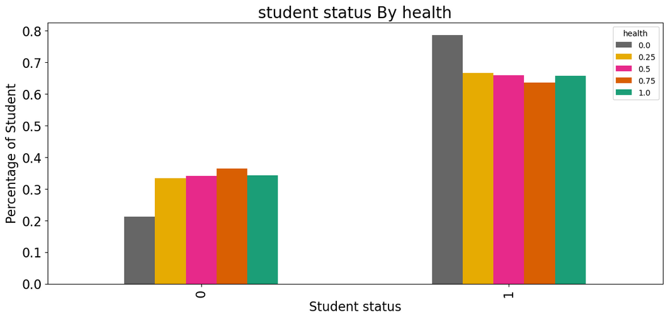
Student status by health:
Most of student who passed the exam had good health

Slide 19
By analyzing these visualizations, we can understand which factors most affect student performance. This helps improve the predictive model and guide educational strategies.
factors affecting students preformance:
1) For the positive impact:
Higher educational aspirations: Students aiming for higher education tend to perform better.
Parental education: Higher education levels of parents positively influence student performance.
Study time: More study hours lead to better academic results.
2) For the negative impact:
Social activities: Spending a lot of time with friends can hurt academic performance.
Previous academic failures: Failing exams in the past often predicts future failures.
Health issues: Poor health can significantly affect academic achievement.
High absenteeism: Frequent school absences can hinder academic performance.
Romantic relationships: Being in a romantic relationship might distract from academic goals.

Slide 20
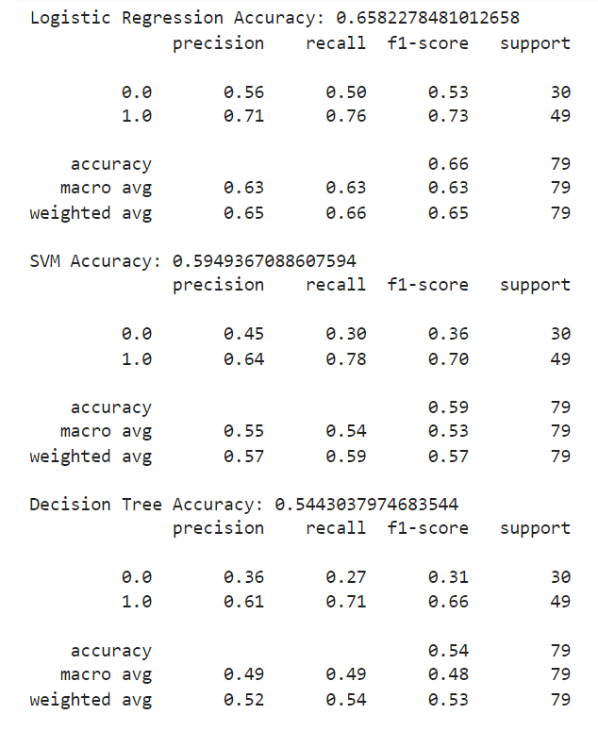
5. Algorithm Selection
We chose three algorithms, Logistic Regression, Decision Tree, and SVM to choose from to train the prediction model. The reason was because Logistic Regression is simple and interpretable, Decision Tree captures complex relationships visually, and SVM handles nonlinear relationships well in smaller data sets.
We created a models and train them and got the result shows the best model for train our dataset.
Best Model: Logistic Regression
Reason:Logistic Regression was chosen for its high accuracy and low risk of overfitting, making it well-suited for the dataset.

Slide 21
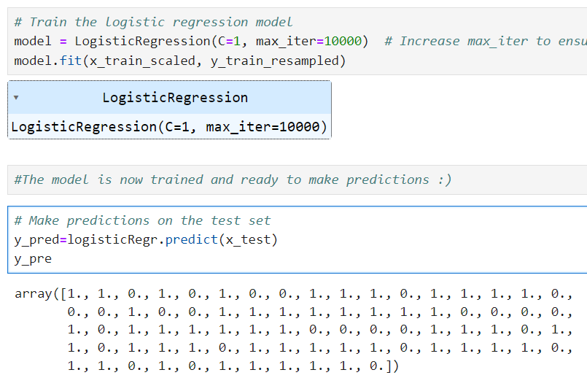
6. Model Traning and Evaluation
Training modle :Logistic Regression:
Model evaluation:
To evaluate a classification model, we will:
Calculate Accuracy: Measures the percentage of correct predictions.
Visualize the Confusion Matrix: Displays correct and incorrect predictions by class.
Plot the ROC Curve: shows how well the model performs at different thresholds, with AUC measuring how good the model is at distinguishing between positive and negative cases.
Recall Evaluation: Assesses the model's ability to identify positive cases.

Slide 22
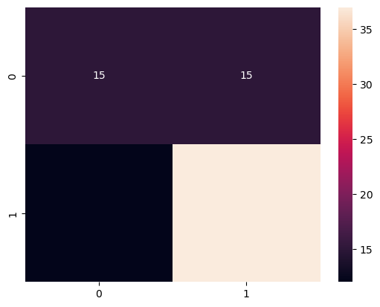
Calculate the Accuracy:
Accuracy test is: 0.6582278481012658
Accuracy train is: 0.6867088607594937
f1 score is: 0.6294945284002085
We obtained two accuracy values, one was obtained using the training set and the other was obtained using the test set.
It may be a good idea to compare the two, as a case where the accuracy of the training set is much higher may indicate overfitting. Test set accuracy is more relevant for evaluating performance on unseen data since it is unbiased.
2- Visualize the Confusion Matrix:
A confusion matrix is a table used to evaluate the performance of a classification model
TP (30): True Positives (actual 1, predicted 1)
FP (15): False Positives (actual 0, predicted 1)
TN (15): True Negatives (actual 0, predicted 0)
FN (0): False Negatives (actual 1, predicted 0)

Slide 23
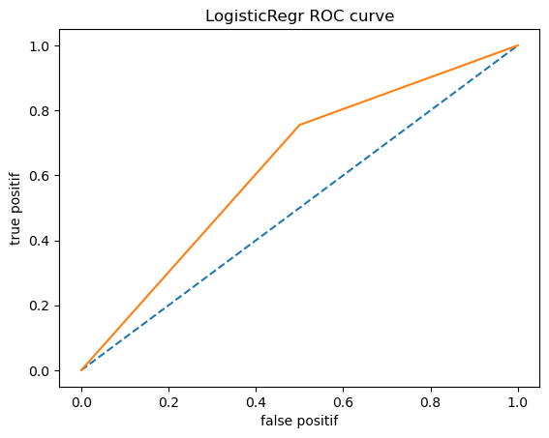
3- Plot the ROC Curve:
ROC Curve:
The ROC curve is a graph that shows how well a binary classification model performs as the threshold for deciding between classes is changed.
Key Components of the ROC Curve
True Positive Rate (TPR):
TPR=True Positives/True Positives+False Negatives
False Positive Rate (FPR) :
FPR=False Positives/False Positives+True Negatives
Diagonal Line:
he dashed diagonal line represents a random classifier that does no better than random guessing.
the ROC curve shows a modest performance, with the true positive rate (TPR) increasing as the false positive rate (FPR) increases. The curve is above the diagonal, indicating the model performs better than random guessing but could be more improve.
4- Recall Evaluation:
Recall measures the model's ability to correctly identify positive cases, ensuring the model's effectiveness in predicting students' academic performance.
Recall: 0.7551020408163265

Slide 24
7. Model Improvements
Techniques Used to Improve Model Accuracy:
Recall Evaluation: We assessed the model using recall, focusing on its ability to correctly identify positive cases and predict students' academic performance.
Hyperparameter Tuning: Using GridSearchCV, we optimized hyperparameters, testing various values for the C and solver parameters ('liblinear', 'lbfgs') to enhance accuracy based on recall.
Optimal Data Splitting: By testing several random splits, we identified an optimal random state (78657622) that ensured high performance and reproducibility.
Final Model Evaluation: After improvements, we re-evaluated the model to confirm its effectiveness.

Slide 25
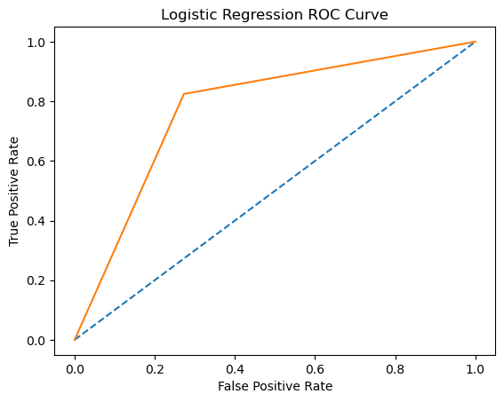
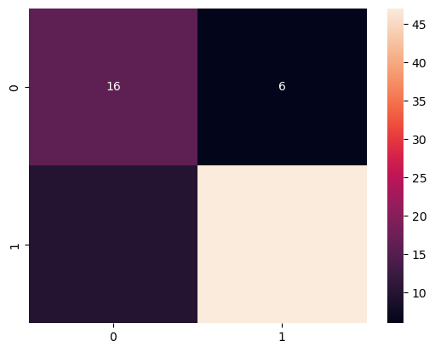
Final Model Evaluation
Accurcy&Recall
ROC curve
*Accuracy is: 79.74683544303798
*f1 score is: 0.7606060606060607
* Recall: 0.8245614035087719
Confusion Matrix
The ROC curve of the improved Logistic Regression model is closer to the top-left corner, showing a higher true positive rate for a given false positive rate. This indicates a significant increase in the model's predictive power.
TP (30): True Positives (actual class 1, predicted class 1)
FP (6): False Positives (actual class 0, predicted class 1)
TN(16): True Negatives (actual class 0, predicted class 0)
FN (0): False Negatives (actual class 1, predicted class 0)

Slide 26
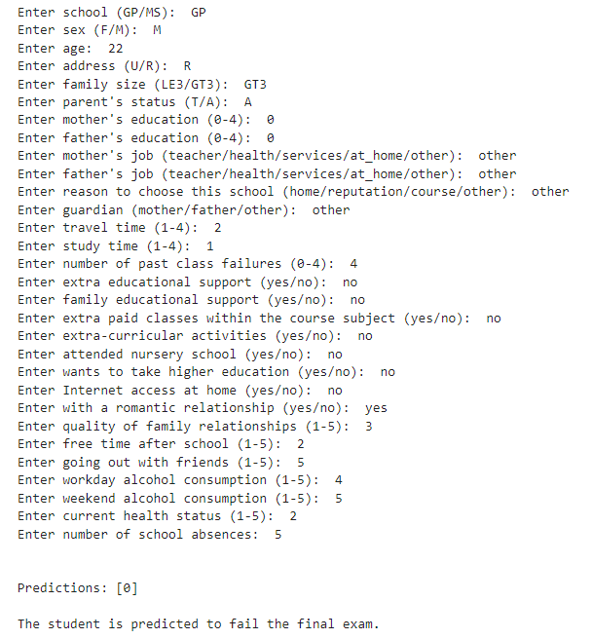
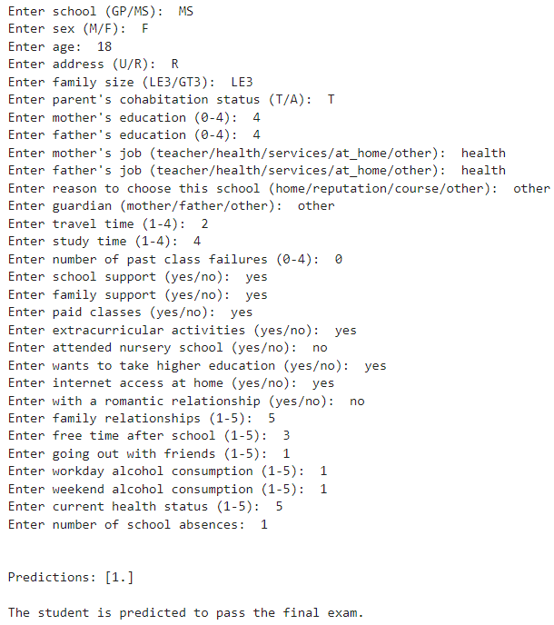
8. Data prediction

Slide 27
Conclusion
The project aimed to predict student performance using machine learning models. Initially, the model faced challenges with imbalanced data and suboptimal hyperparameters, leading to lower accuracy and unbalanced predictions. By addressing class imbalance with SMOTE and optimizing hyperparameters, significant improvements were achieved.
Final results with the Logistic Regression model showed:
Accuracy: Improved from 65% to 79.75%
F1 Score: Improved from 0.63 to 0.82
ROC AUC: Improved from 0.74 to 0.87
These improvements highlight the effectiveness of data preprocessing and hyperparameter tuning. The project successfully created a robust predictive model for student performance, offering valuable insights for educational analytics.

Slide 28
Thank you !
Prepared by :
Meaad Faraj

